Slide 1
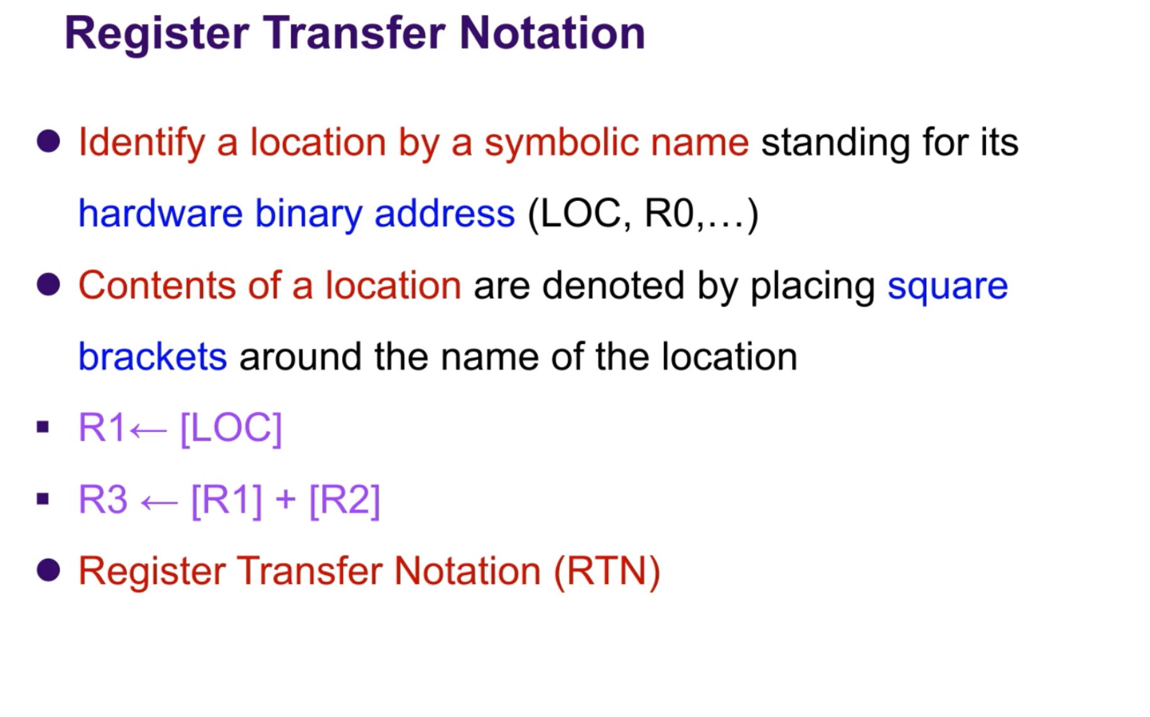

Slide 2


Slide 3
Instruction Formats
Bits of instruction is divided into different fields
﻿﻿Opcode field
﻿﻿Address field
﻿﻿Mode field
﻿﻿No. of address field depends on internal organization of registers
﻿﻿Mainly 3 types of CPU organizations
﻿﻿Single accumulator organization
﻿﻿General register organization
﻿﻿Stack organization,
Based on that 4 types of instruction formats
﻿﻿Three address instructions
﻿﻿Two address instruction
﻿﻿One address instructions

Slide 4

Three address instructions
﻿﻿Computers with three-address instruction formats can use each address field to specify either a processor register or a memory operand.
Advantage :-It results in short program when evaluating arithmetic expressions
﻿﻿Disadvantage:-Binary coded instructions require too many bits to specify 3 address
﻿﻿Ex. Commercial computer Cyber 170

Slide 5
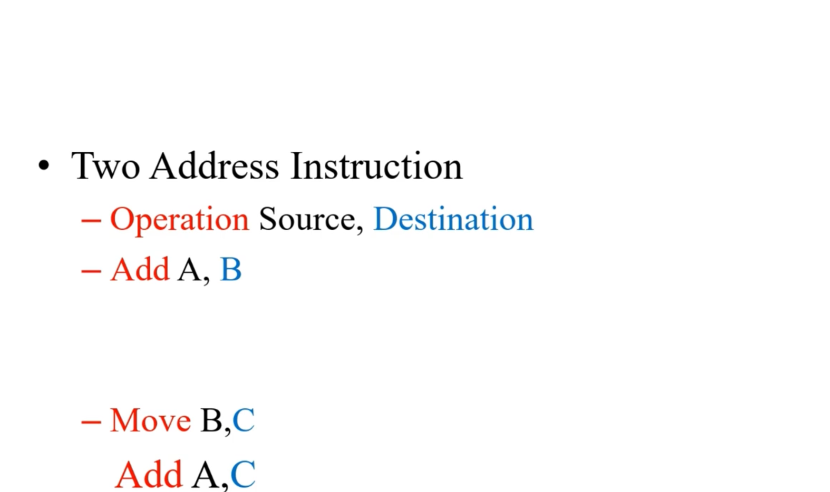
Two-address instructions are the most common in commercial computers.
﻿Here each address field can specify either a processor register or a memory word

Slide 6
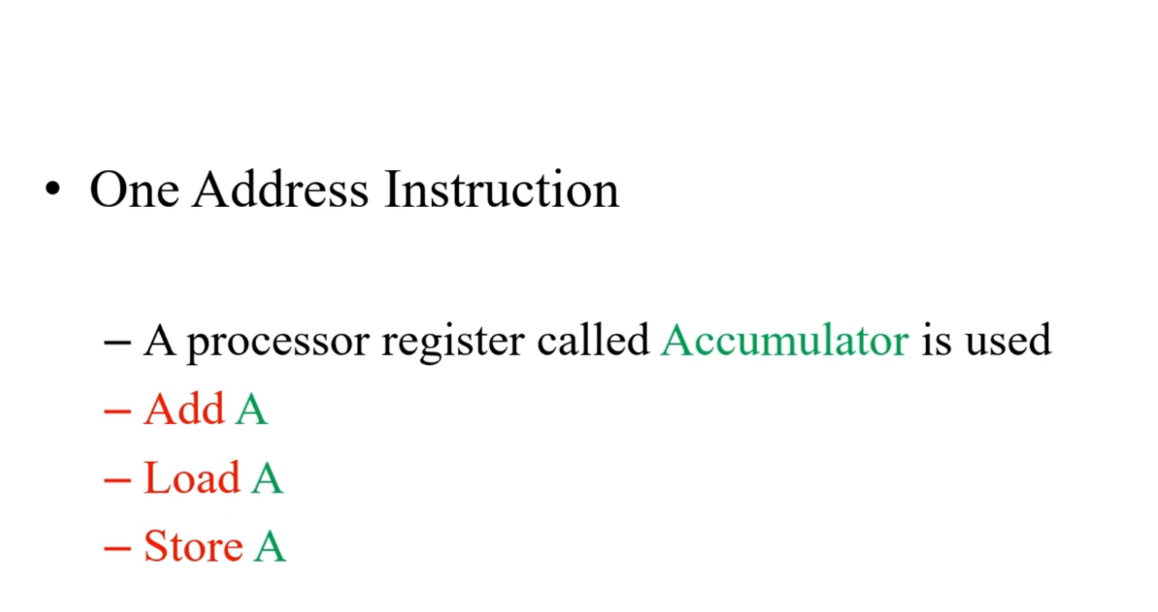
Use an implied accumulator register (AC) for all data manipulation

Slide 7
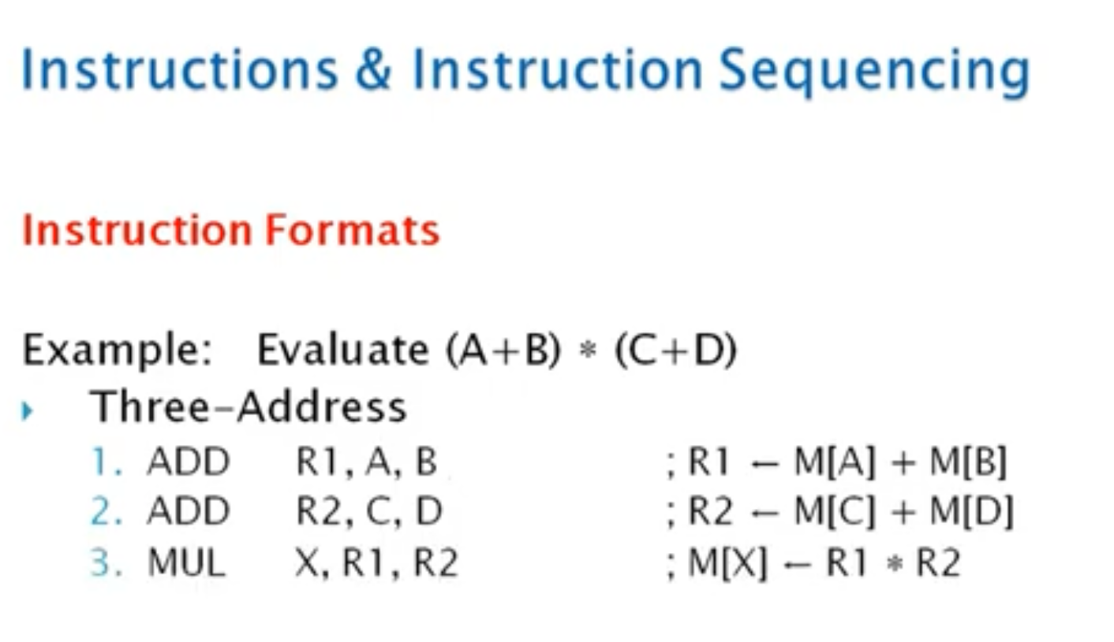

Slide 10
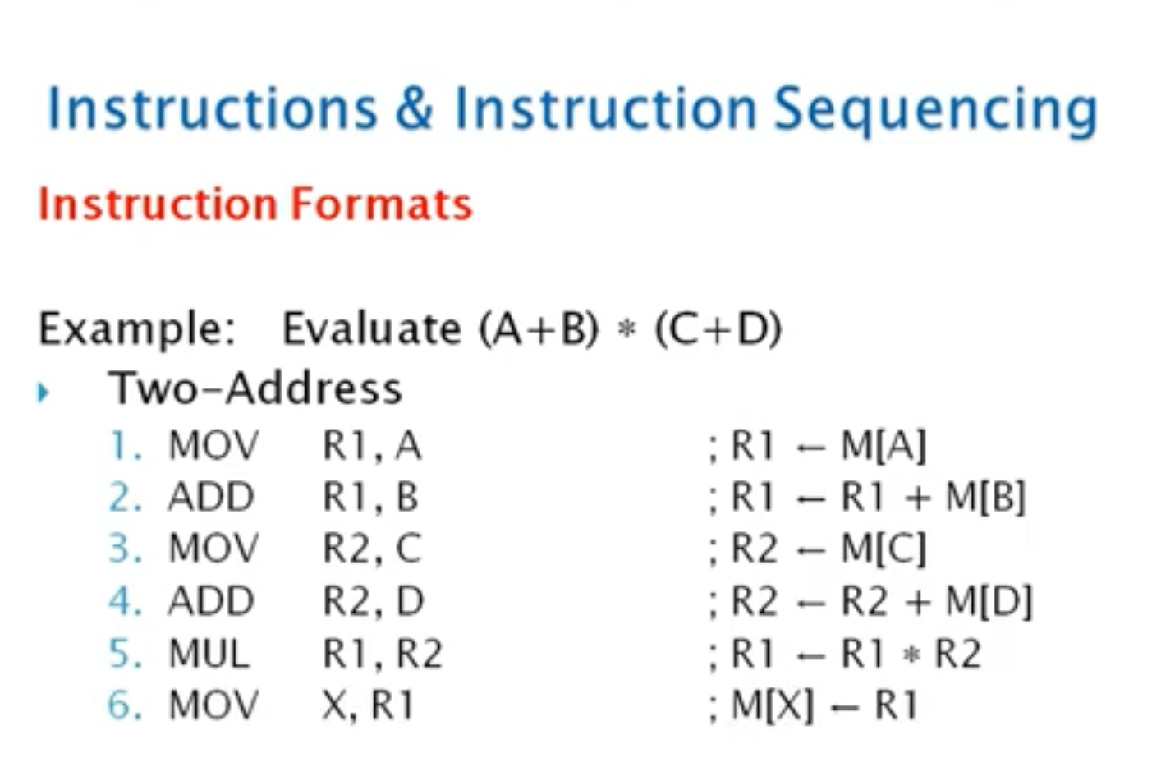

Slide 12
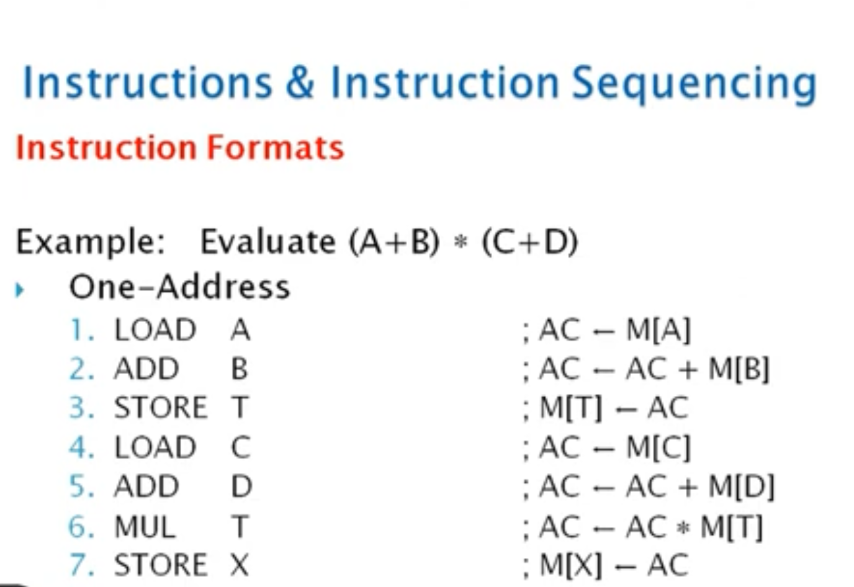
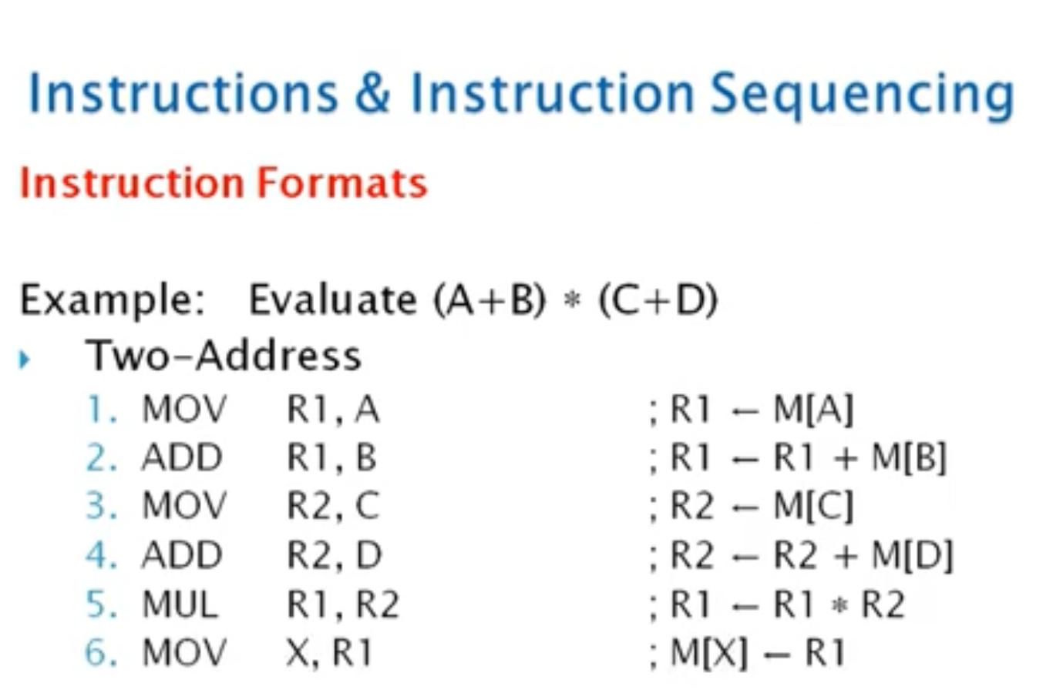

Slide 14
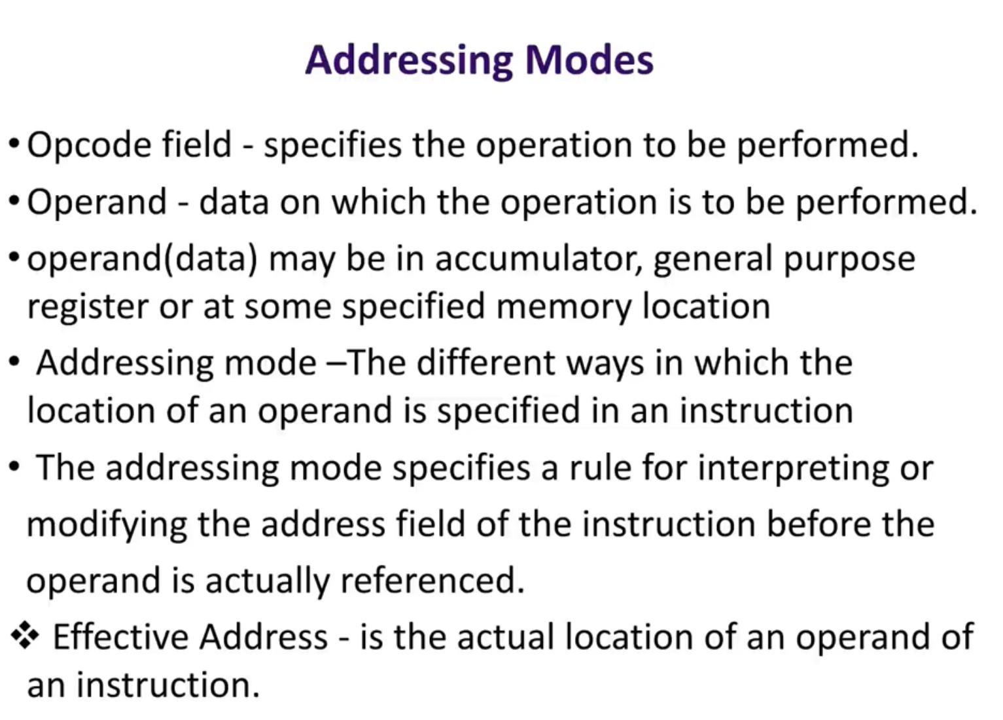

Slide 15
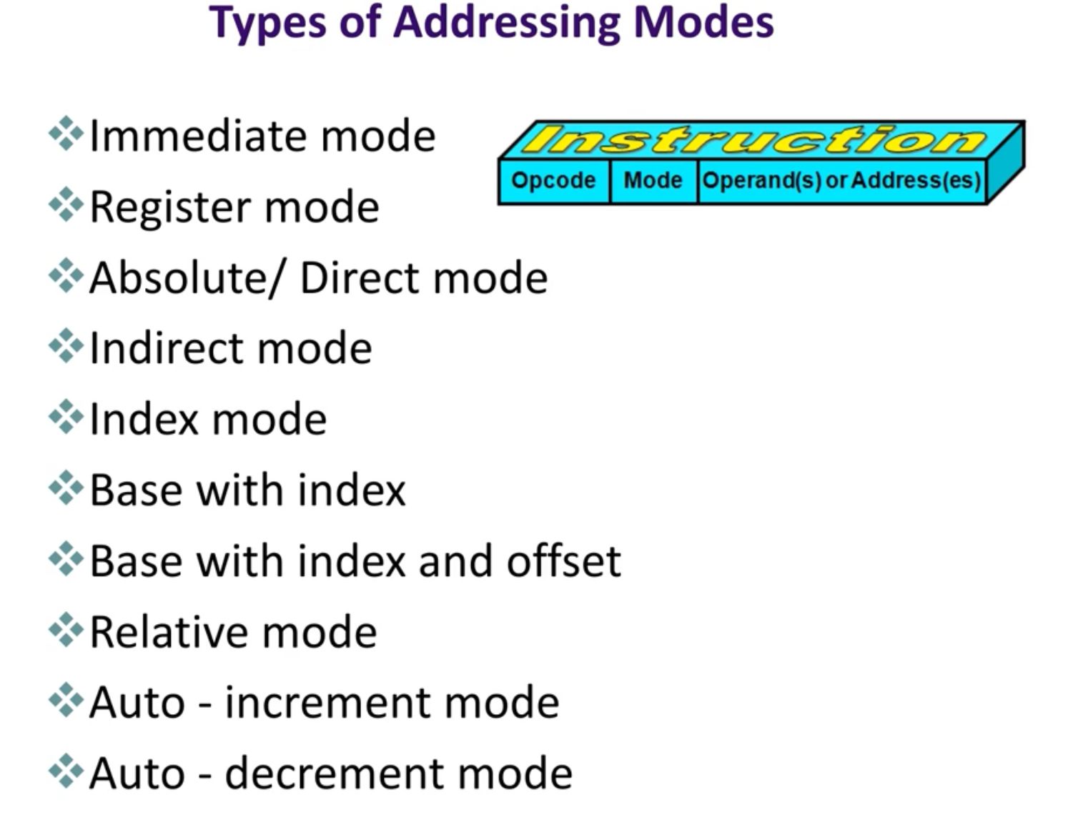

Slide 16
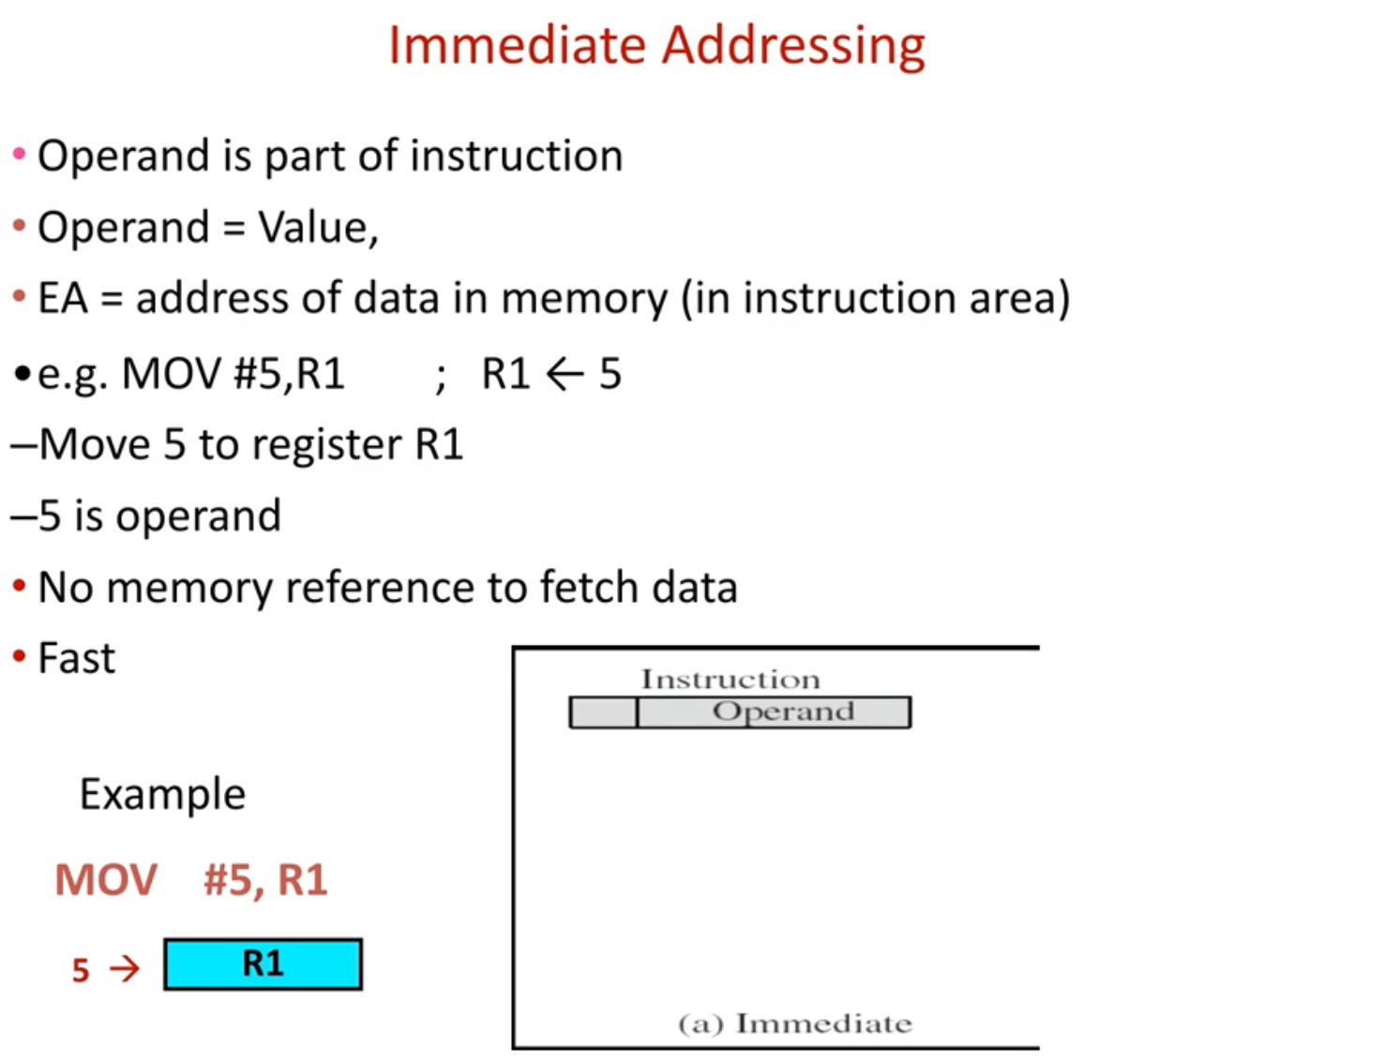

Slide 17
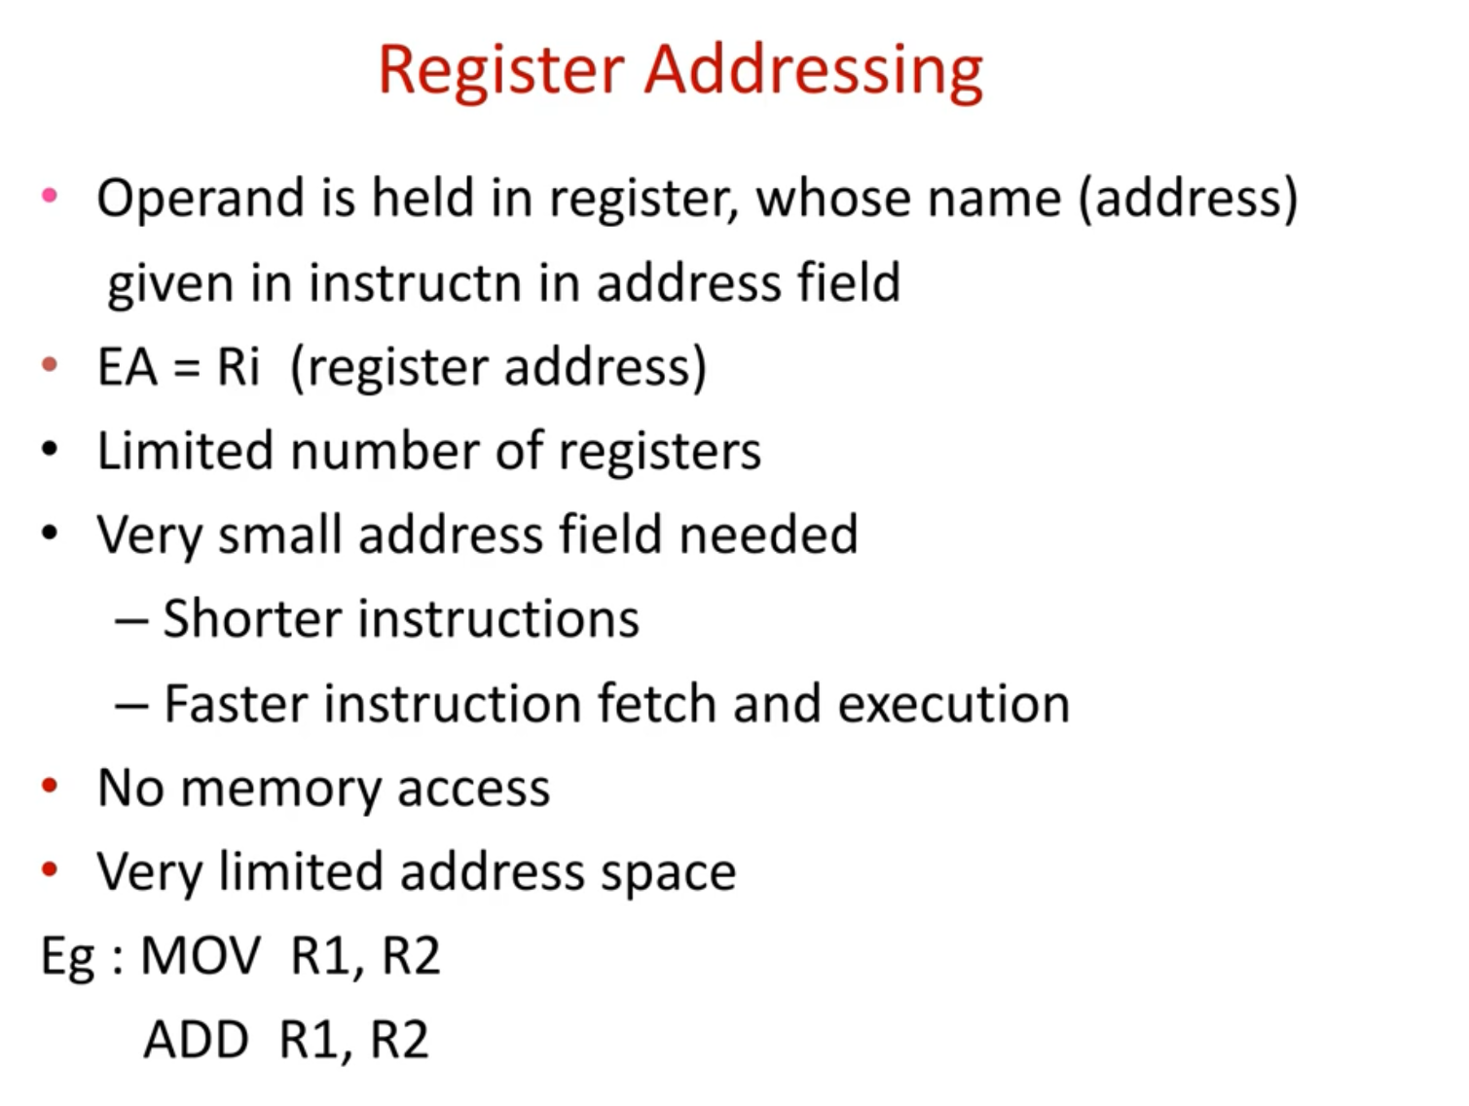

Slide 18
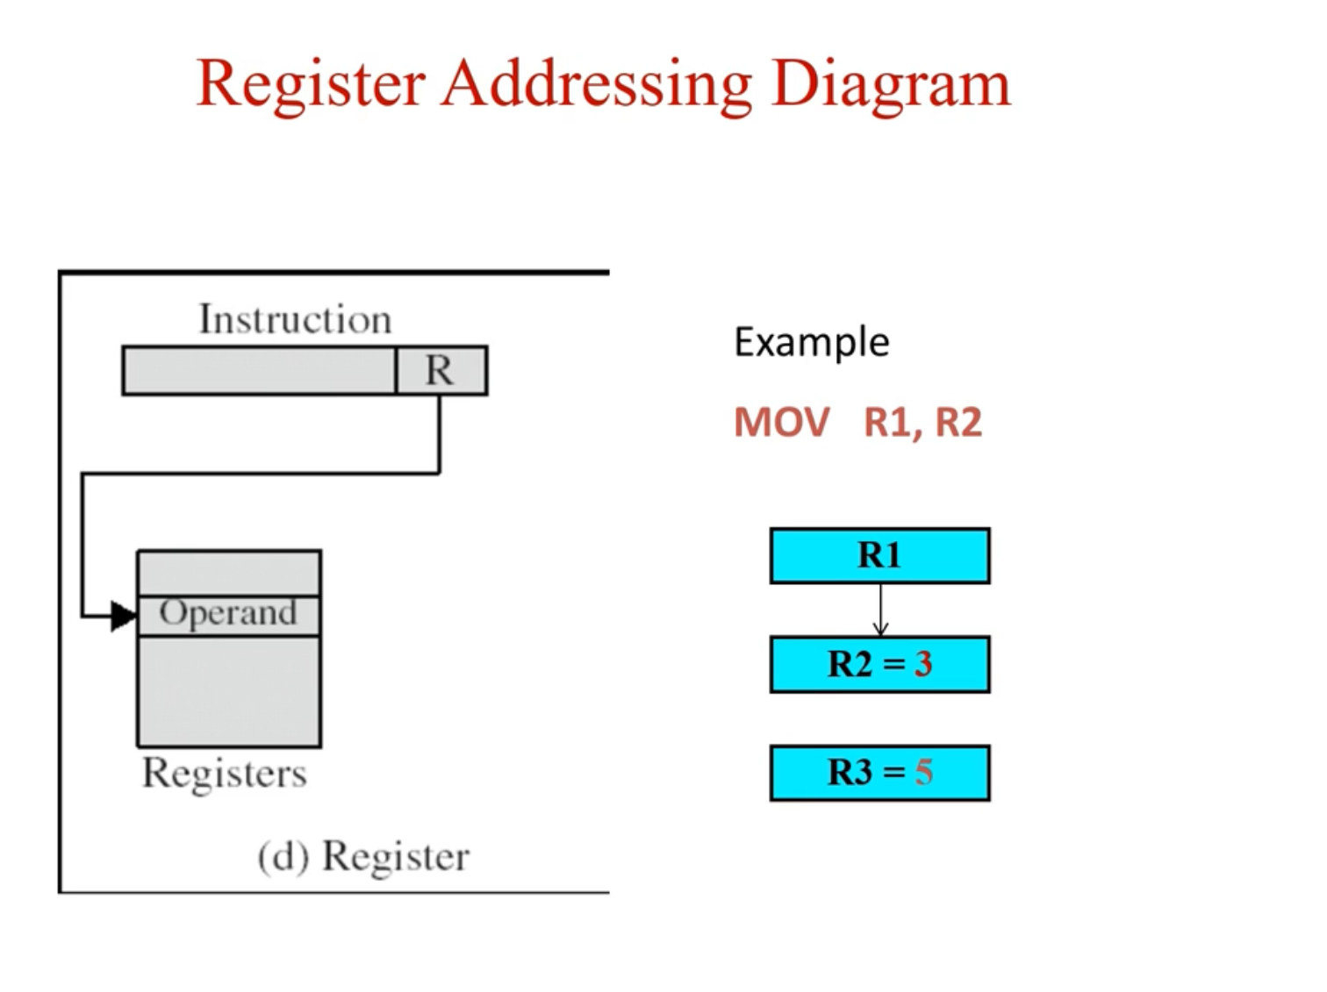

Slide 19
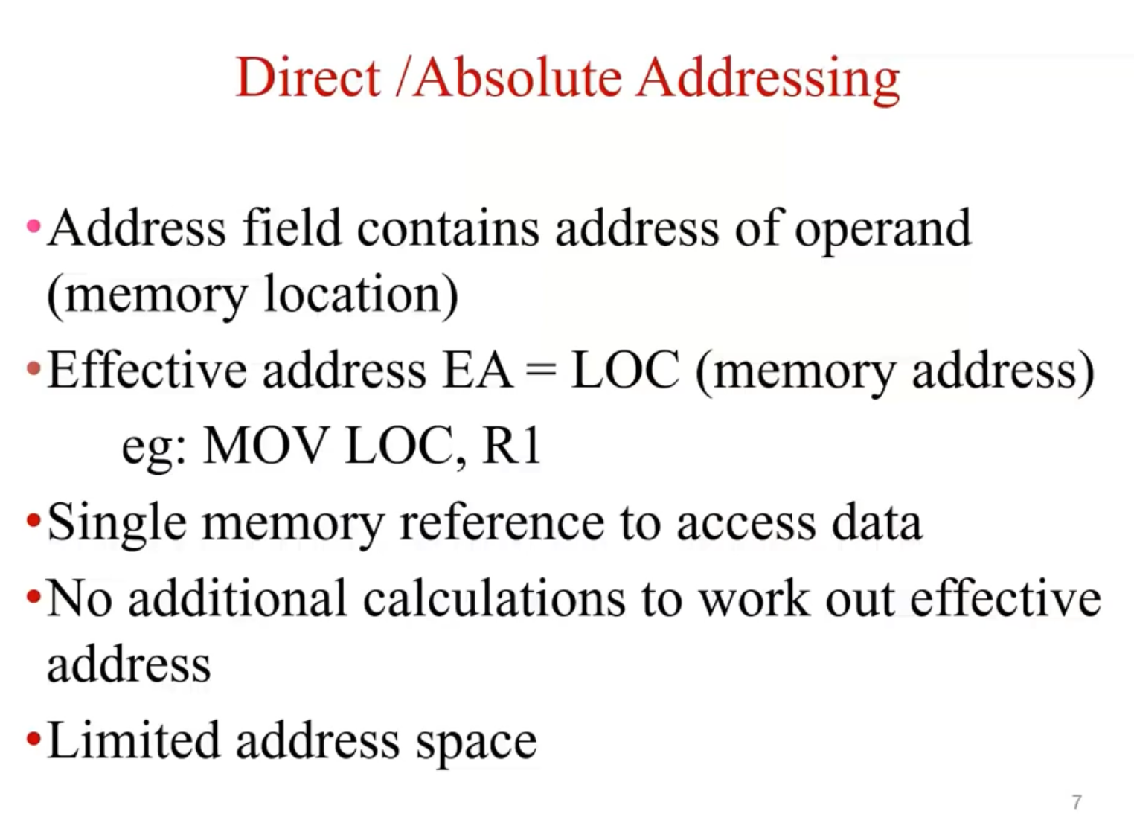

Slide 20
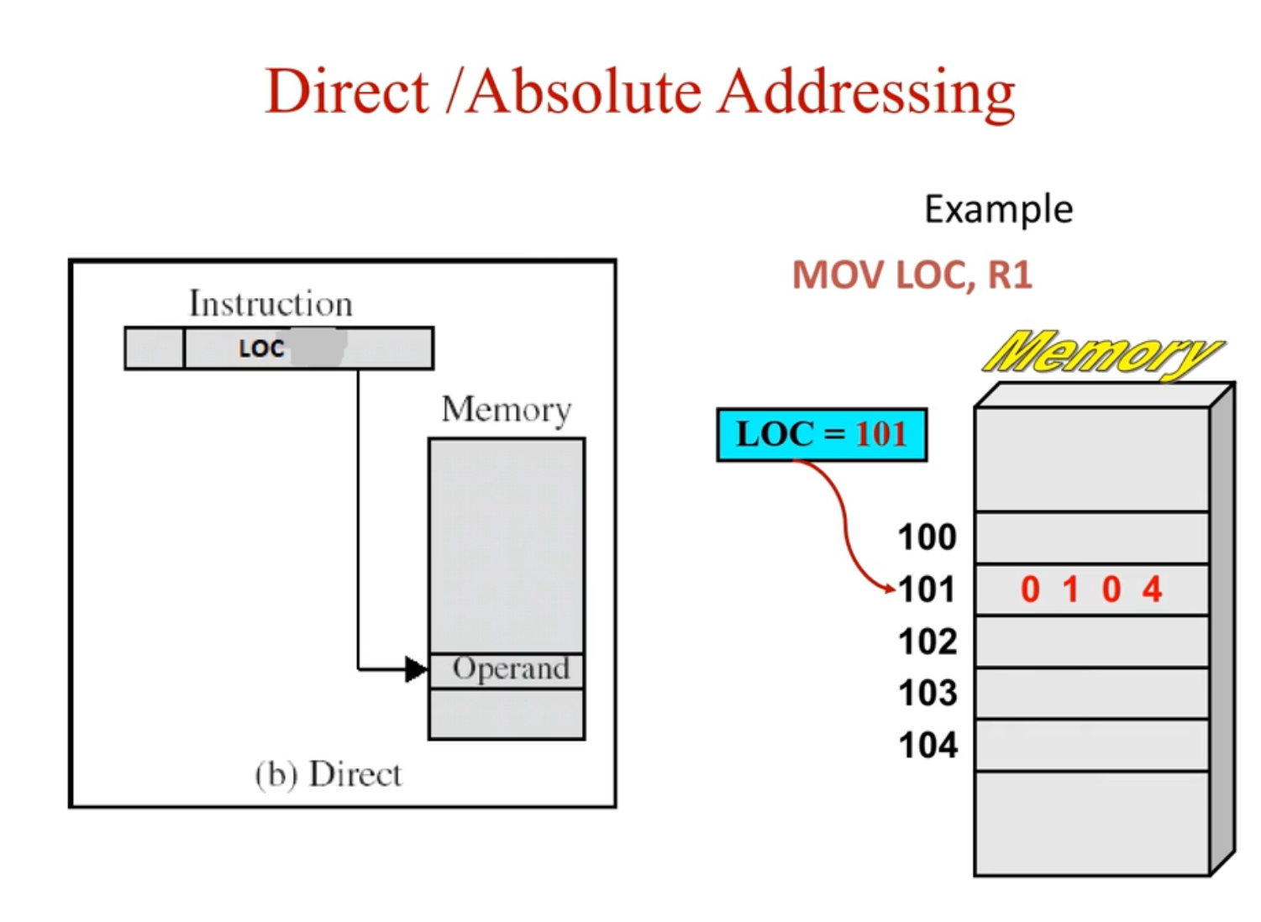

Slide 21

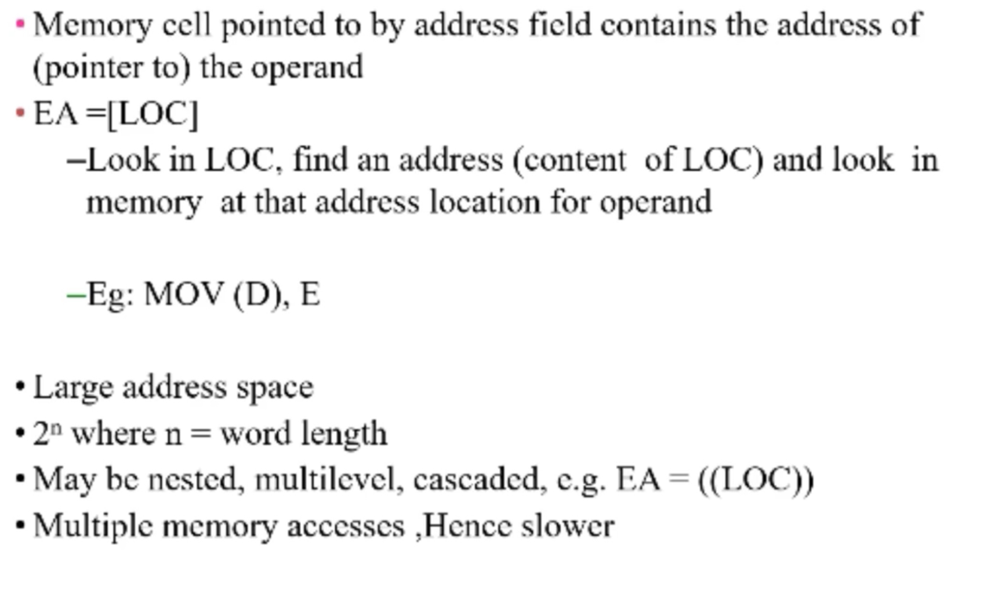

Slide 22
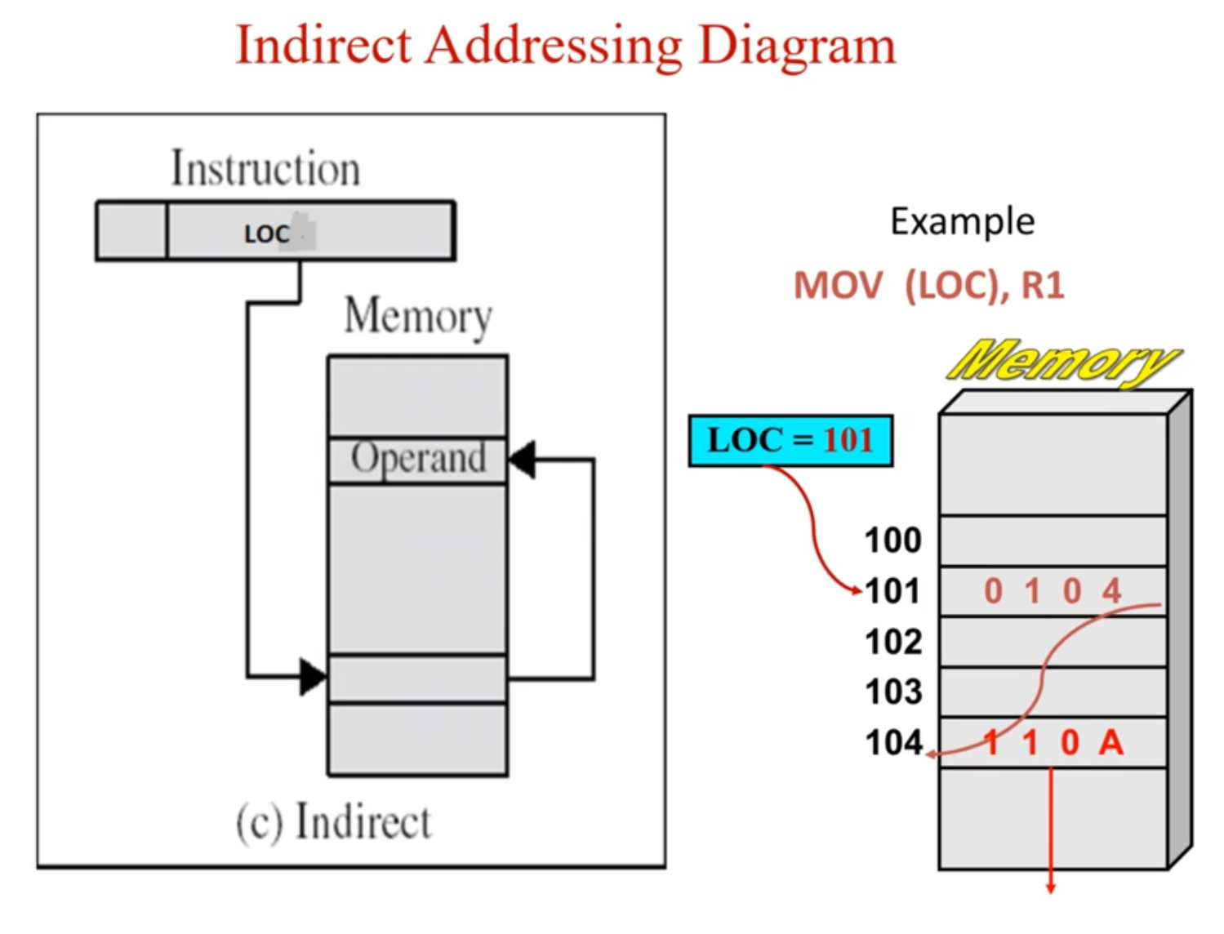

Slide 23
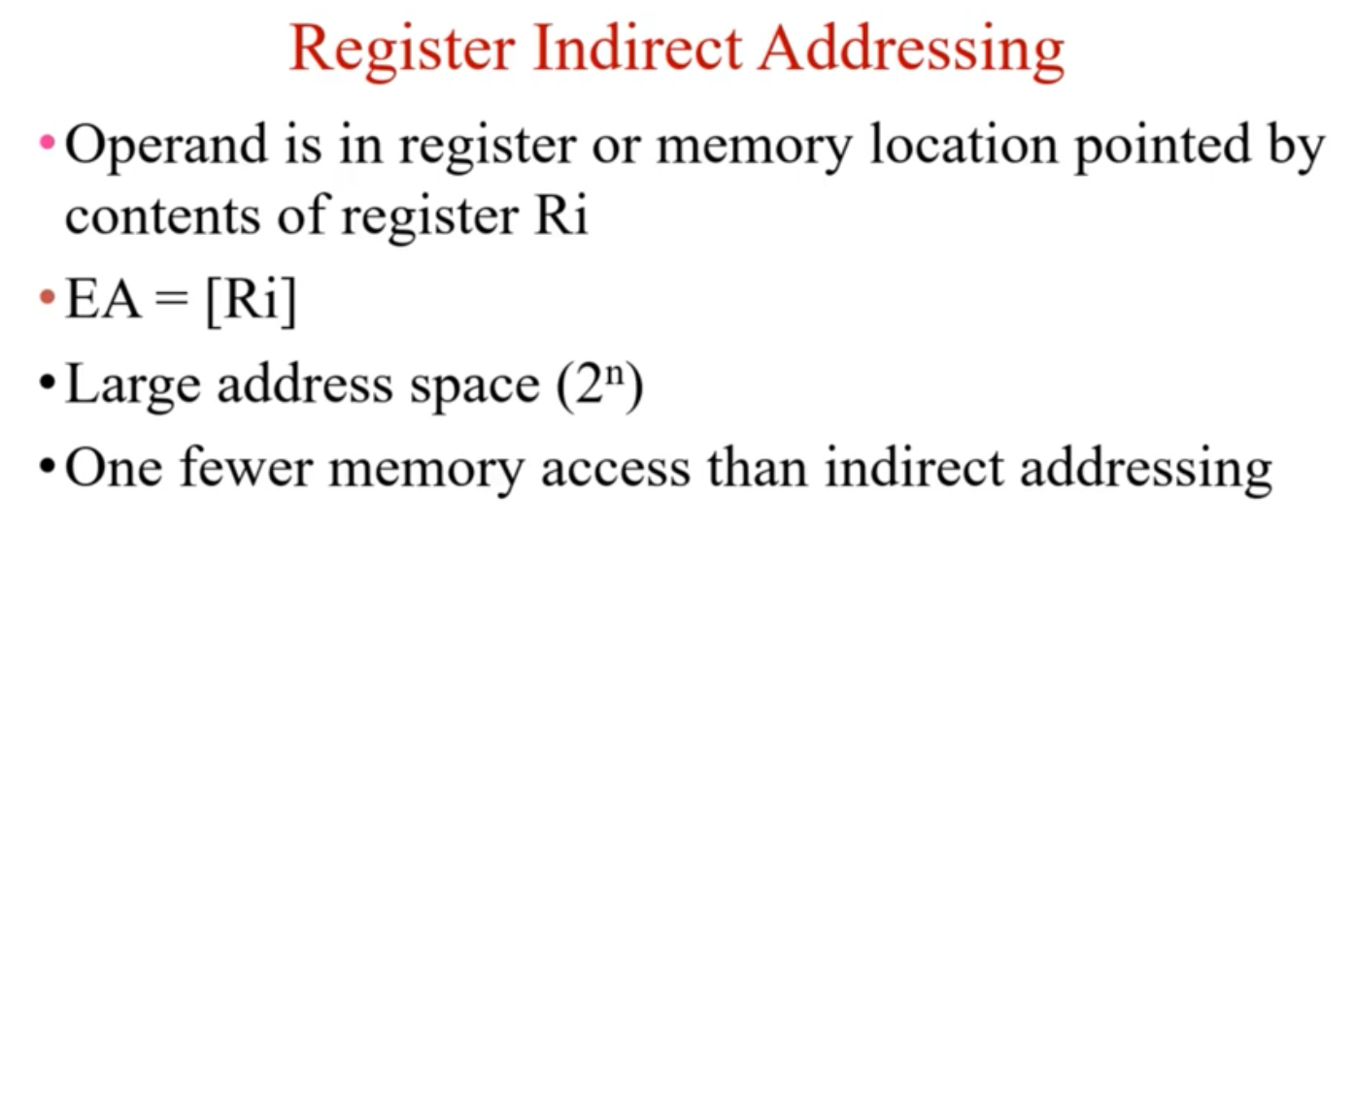

Slide 24
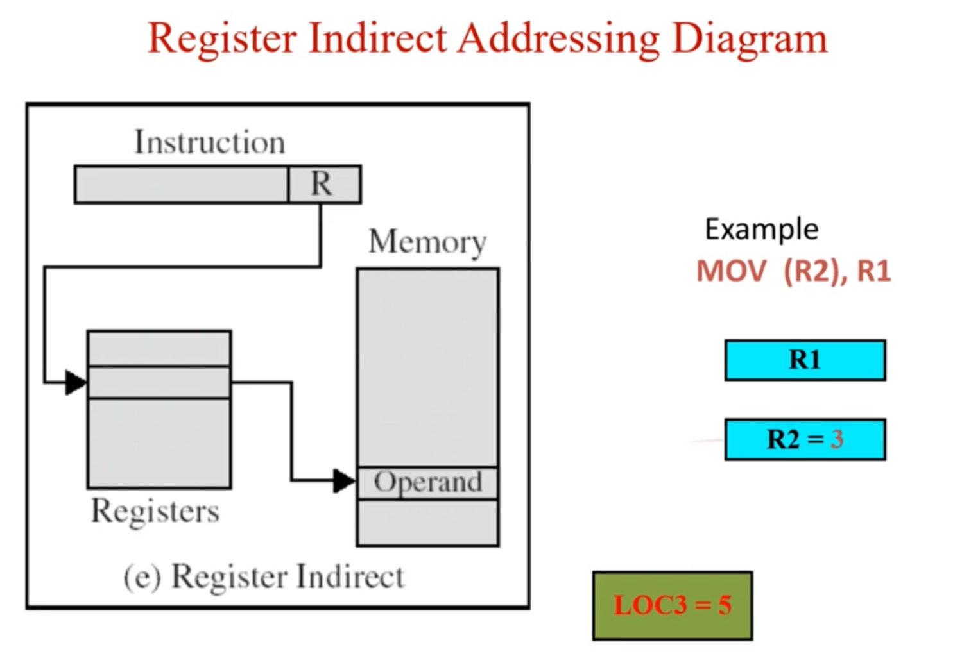

Slide 25
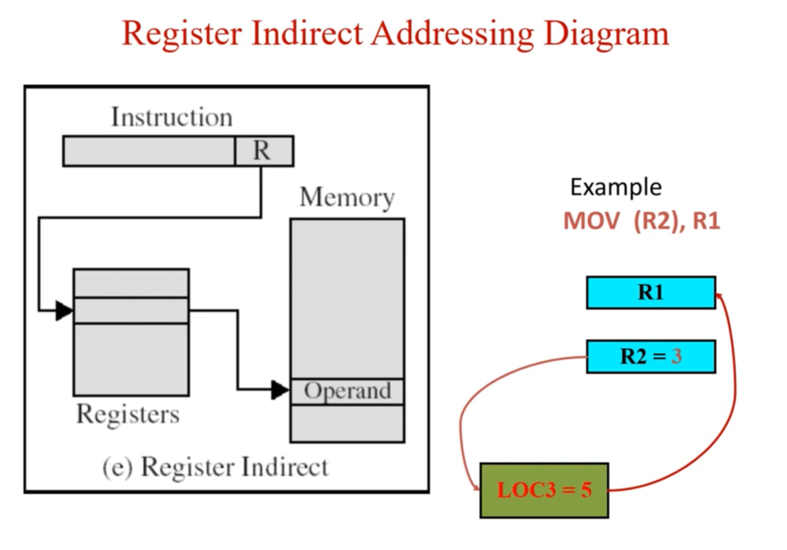

Slide 26
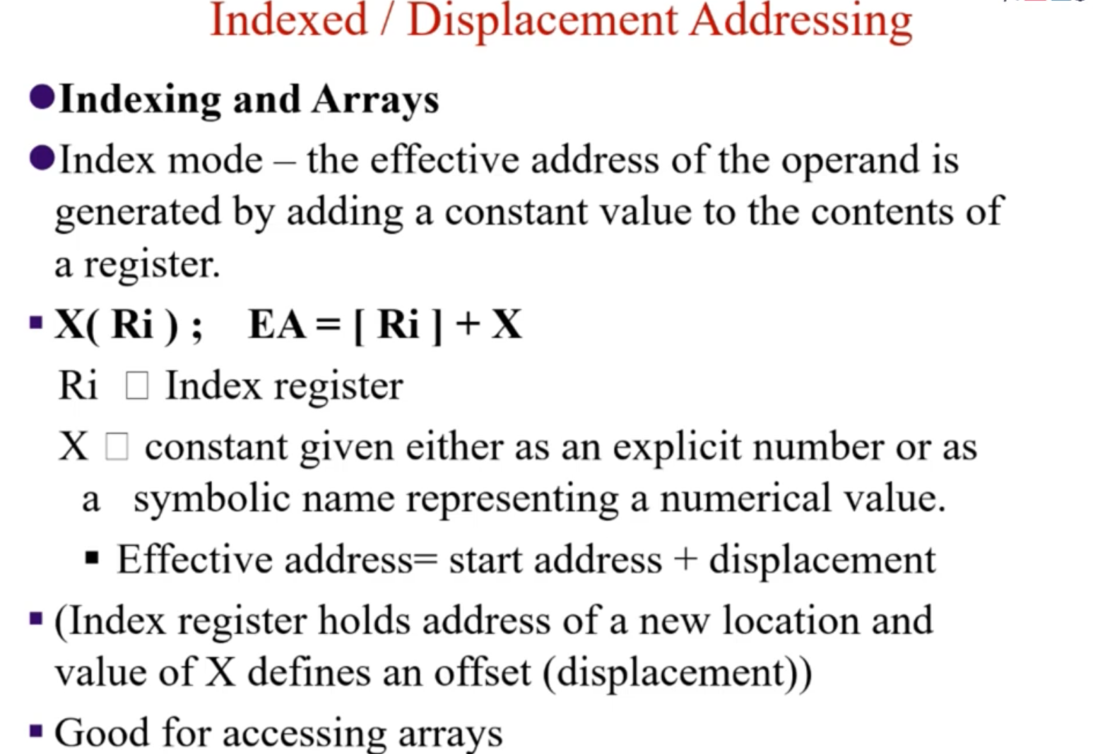

Slide 27
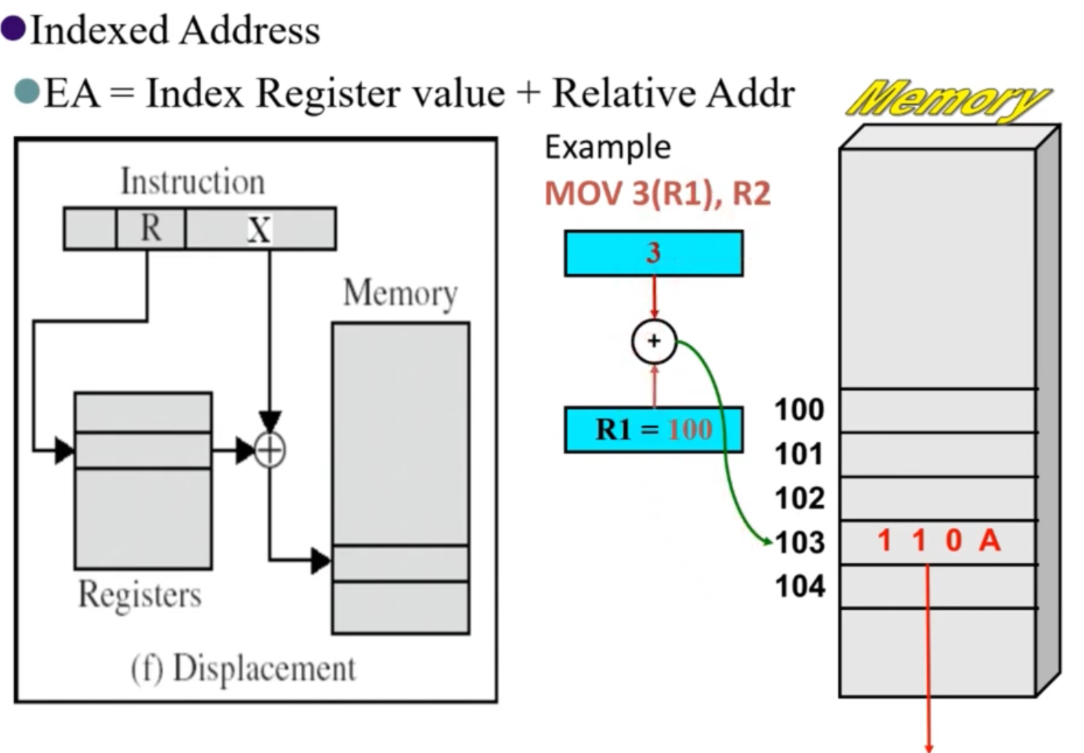

Slide 28

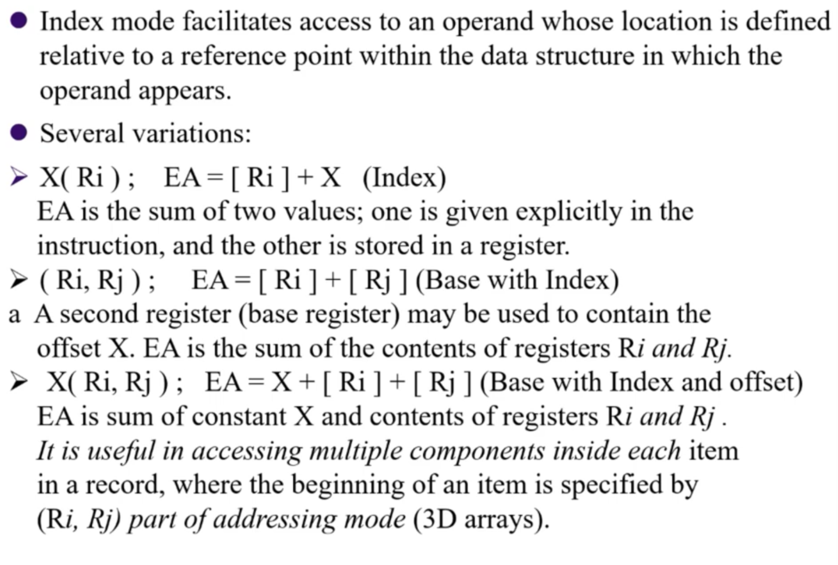

Slide 29

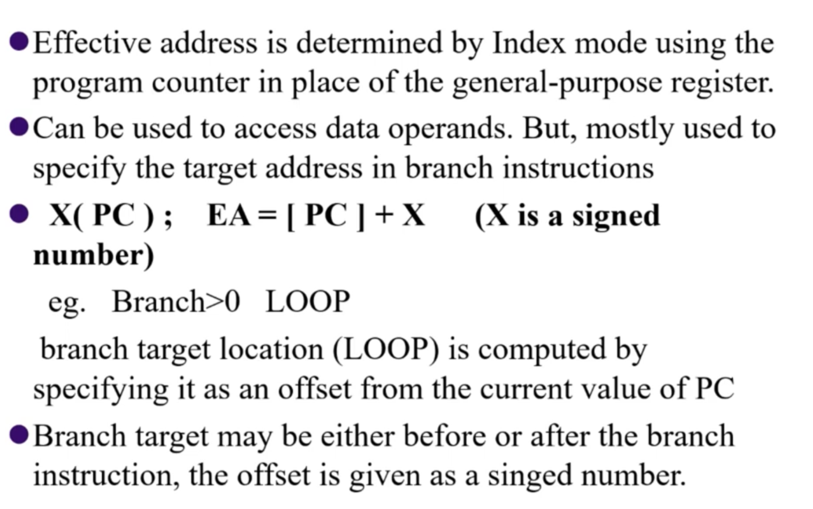

Slide 30
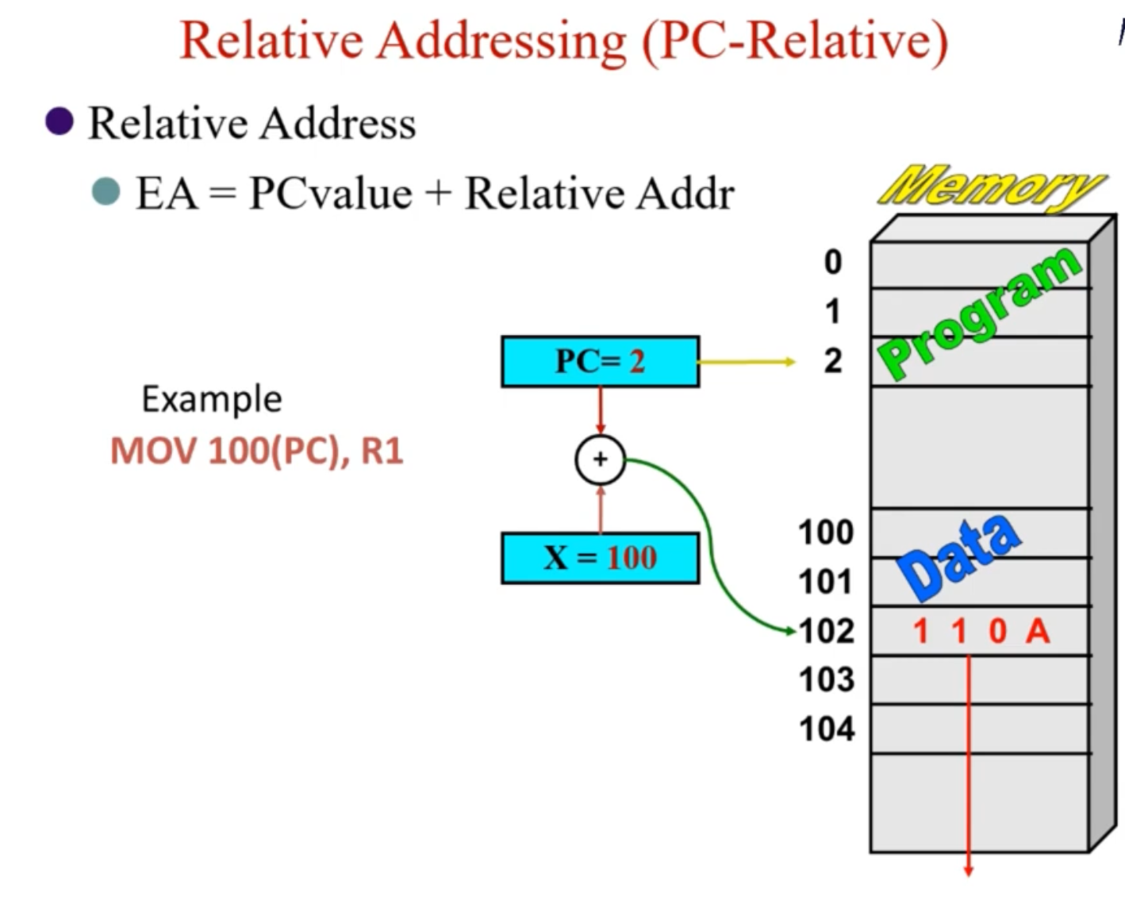

Slide 31

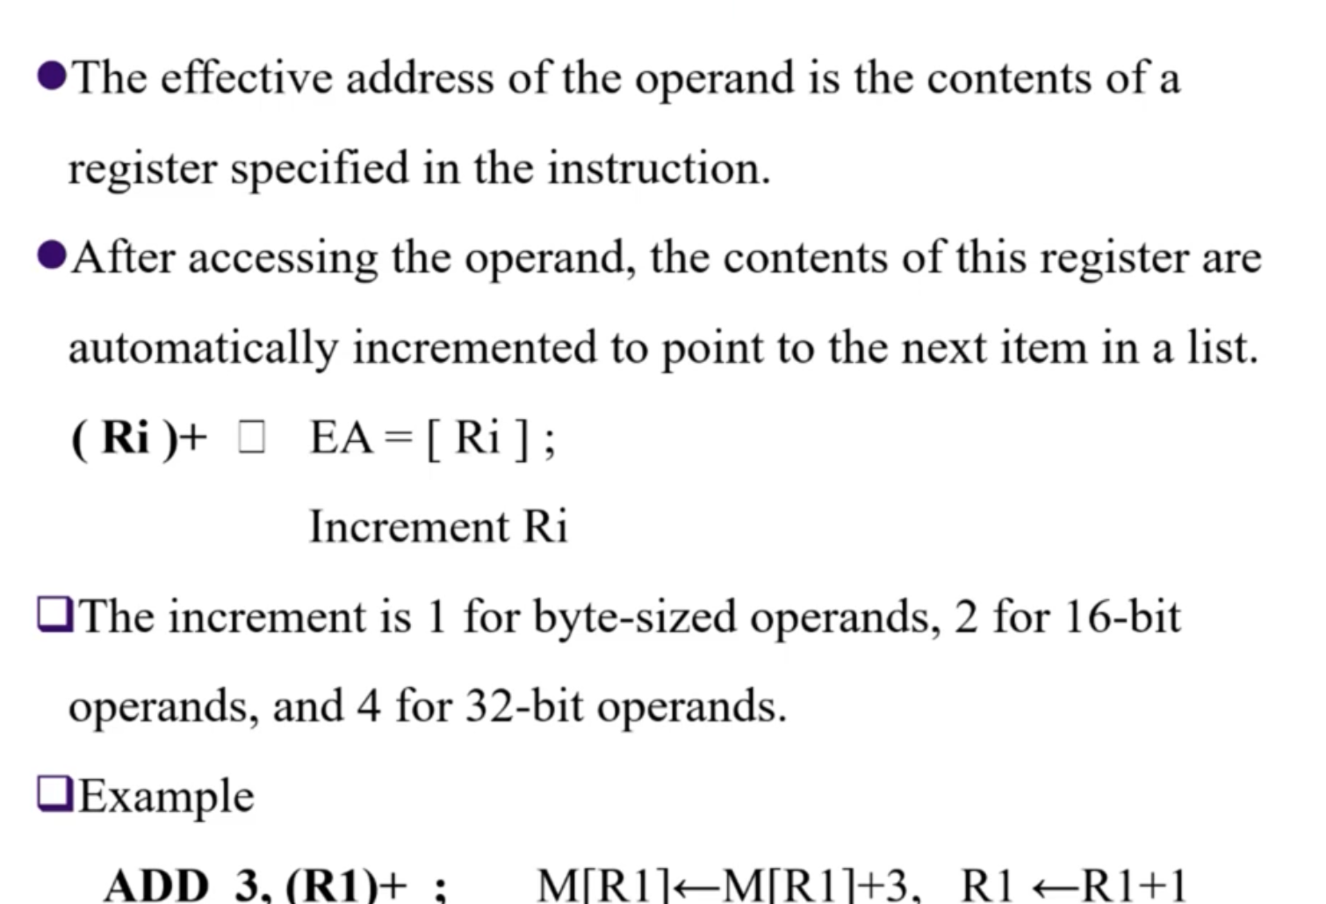

Slide 32
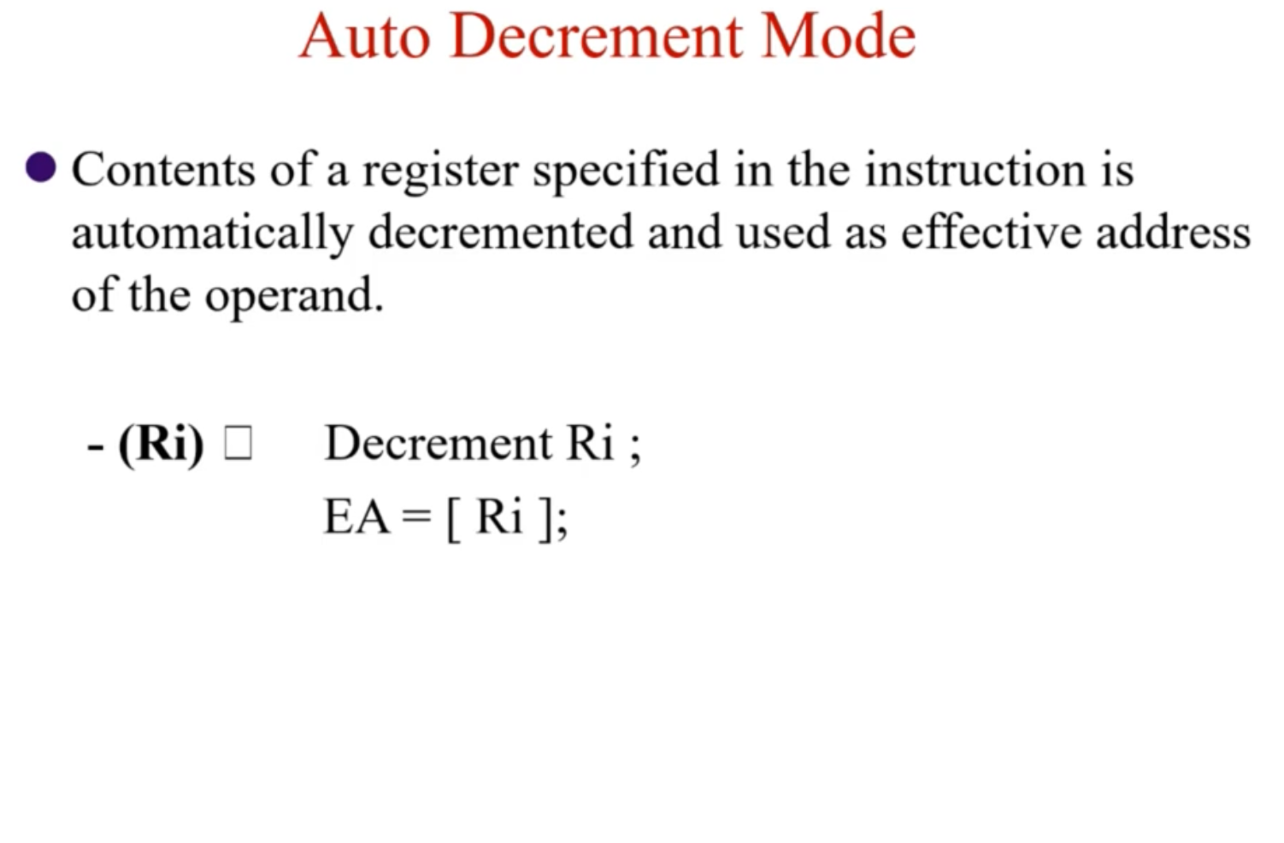

Slide 33

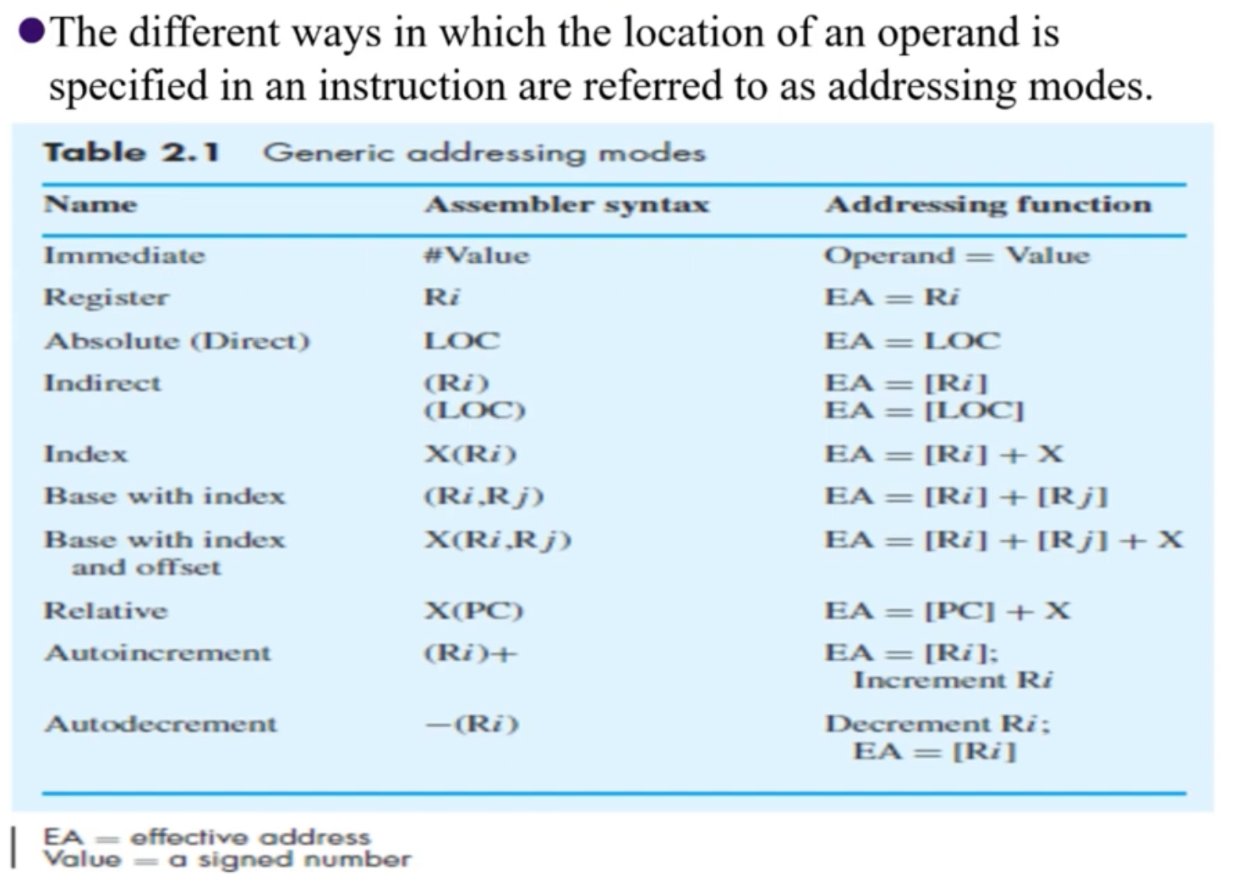

Slide 34


